Slide 1
???
Did you know….
A presentation by Larry Taman for Melancthon Against Quarries

Slide 2
Premier ford
Backtracked on the Greenbelt
Backtracked on bike lanes
Says Ontario needs more aggregate
He will back track on the blast quarry
Notes:
My neighbour is an experience pump and well guy. He said simply at the beginning that once the blasting starts no one can predict where the water will go. A senior hydrologist recently confirmed

Slide 3
Sylvia JOnes
Ms Jones: Deputy Premier/Minister of Health
Our MPP
What has she said or done to understand or defend our concerns? Name one thing?
She met with the Ontario Stone, Sand and Gravel Association
Check it out on her Insta – April 24_2024
Notes:
My neighbour is an experience pump and well guy. He said simply at the beginning that once the blasting starts no one can predict where the water will go. A senior hydrologist recently confirmed

Slide 4
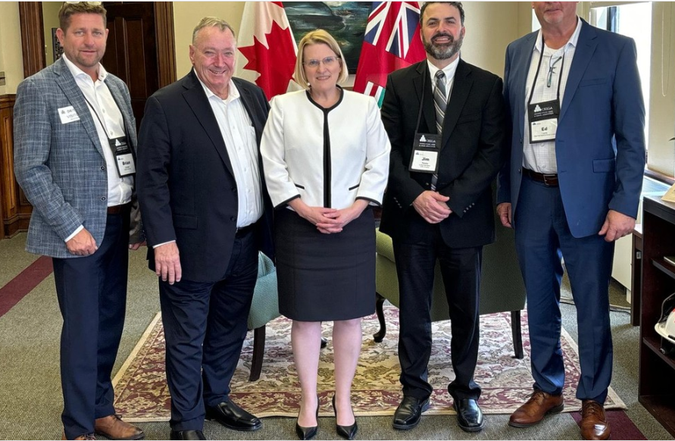
Ms Jones and OssGA
Notes:
My neighbour is an experience pump and well guy. He said simply at the beginning that once the blasting starts no one can predict where the water will go. A senior hydrologist recently confirmed

Slide 5
Kevin Powers
Public relations rep for Strada
Reported as a strong advocate against “NIMBY” opposition to gravel projects
His website says
  We help clients developing a pit or quarry to identify and organize community support and calm fears about dust, traffic and environmental issues…our team help developers find, organize and give voice to otherwise silent supporters of your project”
Notes:
My neighbour is an experience pump and well guy. He said simply at the beginning that once the blasting starts no one can predict where the water will go. A senior hydrologist recently confirmed

Slide 6
Mr. DeGasperis
Greenbelt? He was at the heart of it
Politics? Reported as a donor to the PC Party
Has he ever managed a major water works project
He offers zero in compensation if it all goes bad. Zero.
Notes:
My neighbour is an experience pump and well guy. He said simply at the beginning that once the blasting starts no one can predict where the water will go. A senior hydrologist recently confirmed

Slide 7
The experts
The information contained in this document is solely for the use of the Client identified on the cover sheet for the purpose for which it has been prepared and Tatham Engineering Limited and Earthfx Incorporated undertakes no duty to or accepts any responsibility to any third party who may rely upon this document.
Notes:
My neighbour is an experience pump and well guy. He said simply at the beginning that once the blasting starts no one can predict where the water will go. A senior hydrologist recently confirmed

Slide 8
did you know
People in Melancthon have never opposed a pit
Blasting a huge crater in the aquifer is different
“25 twenty-story office buildings of average floor plate size on a 200-acre site after allowing approximately 30% for roads and other non-building uses”
Where will our water go? And our clean air, our safe back yards, the vibrant eco-system, our secure commutes…..
Notes:
My neighbour is an experience pump and well guy. He said simply at the beginning that once the blasting starts no one can predict where the water will go. A senior hydrologist recently confirmed

Slide 9
Thank you
Melancthon Against Quarries
www.juststopit.ca

